Slide 1
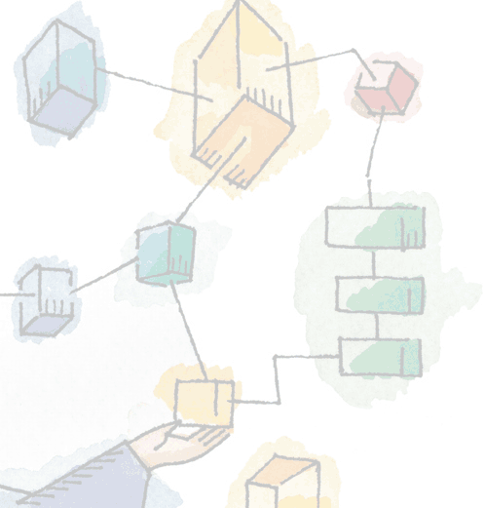
Chapter 2 Operating System Overview
Operating Systems: Internals and Design Principles, 6/E William Stallings

Slide 2
Operating System
A program that controls the execution of application programs
An interface between applications and hardware

Slide 3
Operating System Objectives
Convenience
Efficiency
Ability to evolve

Slide 4
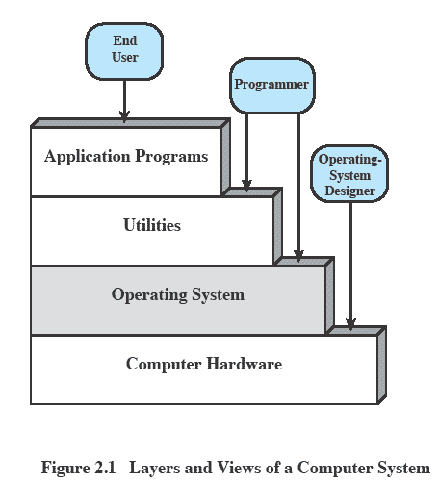
Layers and Views

Slide 5
Services Provided by the OS
Program development
Editors and debuggers
Program execution
Access I/O devices
Controlled access to files
System access

Slide 6
Operating System
Responsible for managing resources
Functions same way as ordinary computer software
It is a program that is executed
Operating system relinquishes control of the processor

Slide 7
Services Provided by the OS
Error detection and response
Internal and external hardware errors
Software errors
Operating system cannot grant request of application

Slide 8
Services Provided by the OS
Accounting
Collect usage statistics
Monitor performance
Used to anticipate future enhancements
Used for billing purposes

Slide 9
Operating System
Responsible for managing resources
Functions same way as ordinary computer software
It is a program that is executed
Operating system relinquishes control of the processor

Slide 10
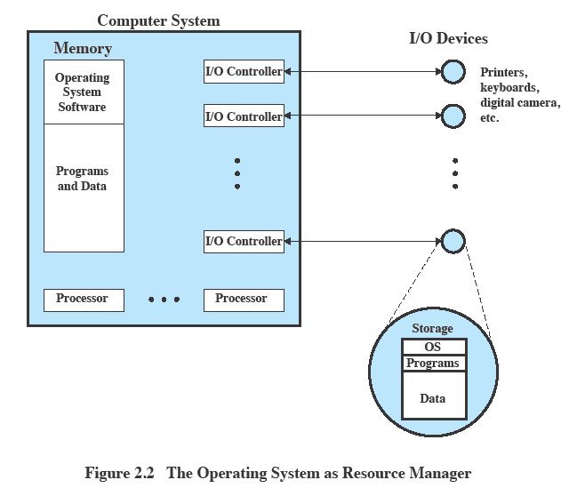
OS as Resource Manager

Slide 11
Kernel
Portion of operating system that is in main memory
Contains most frequently used functions
Also called the nucleus

Slide 12
Evolution of Operating Systems
Hardware upgrades plus new types of hardware
New services
Fixes

Slide 13
Evolution of Operating Systems
Serial processing
No operating system
Machines run from a console with display lights, toggle switches, input device, and printer

Slide 14
Evolution of Operating Systems
Serial processing
Schedule time
Setup included loading the compiler, source program, saving compiled program, and loading and linking

Slide 15
Evolution of Operating Systems
Simple batch system
Monitor
Software that controls the sequence of events
Batch jobs together
Program returns control to monitor when finished

Slide 16
Job Control Language
Special type of programming language
Provides instruction to the monitor
What compiler to use
What data to use

Slide 17
Hardware Features
Memory protection
Does not allow the memory area containing the monitor to be altered
Timer
Prevents a job from monopolizing the system
Privileged instructions
Certain machine level instructions can only be executed by the monitor
Interrupts
Early computer models did not have this capability

Slide 18
Memory Protection
User program executes in user mode
Certain instructions may not be executed
Monitor executes in system mode
Kernel mode
Privileged instructions are executed
Protected areas of memory may be accessed

Slide 19
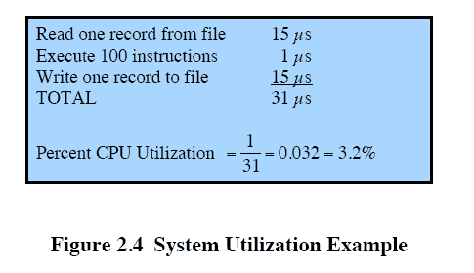
System Utilization Example

Slide 20

Uniprogramming
Processor must wait for I/O instruction to complete before proceeding

Slide 21
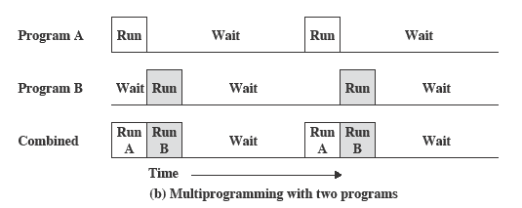
Multiprogramming
When one job needs to wait for I/O, the processor can switch to the other job

Slide 22
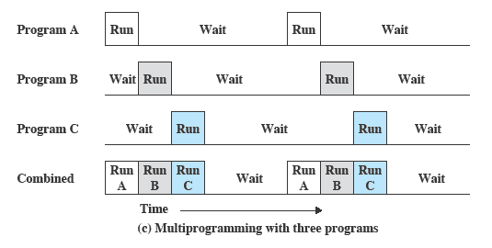
Multiprogramming

Slide 23
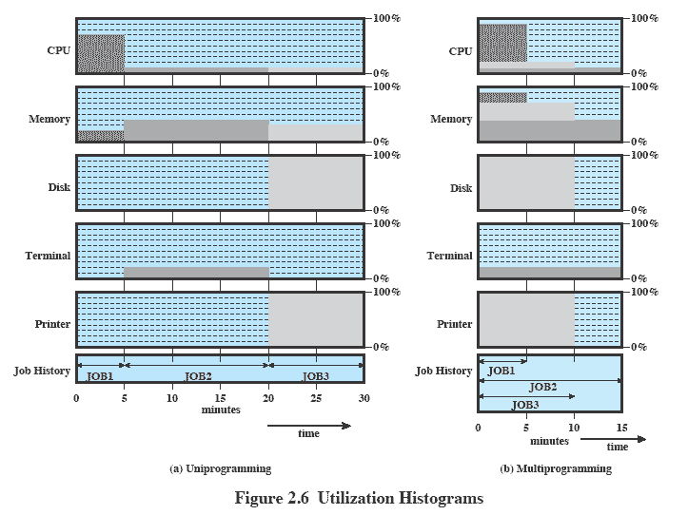
Utilization Histograms

Slide 24
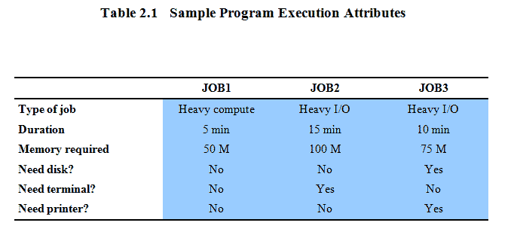
Example

Slide 25
Time Sharing Systems
Using multiprogramming to handle multiple interactive jobs
Processor’s time is shared among multiple users
Multiple users simultaneously access the system through terminals

Slide 26
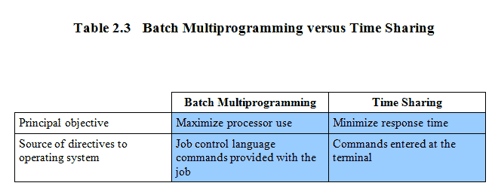
Batch Multiprogramming versus Time Sharing

Slide 27
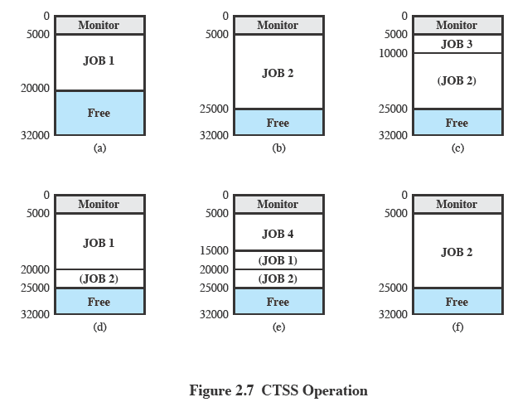
Resource usage monitoring
Compatible Time Sharing System (CTSS)

Slide 28
Major Achievements
Processes
Memory management
Information protection and security
Scheduling and resource management
System structure

Slide 29
Process
A program in execution
An instance of a program running on a computer
The entity that can be assigned to and executed on a processor

Slide 30
Process
A unit of activity characterized by
A single sequential thread of execution
A current state
An associated set of system resources

Slide 31
Difficulties with Designing System Software
Improper synchronization
Failed mutual exclusion
Nondeterminate program operation
Deadlocks

Slide 32
Process
Consists of three components
An executable program
Associated data needed by the program
Execution context of the program
All information the operating system needs to manage the process

Slide 33
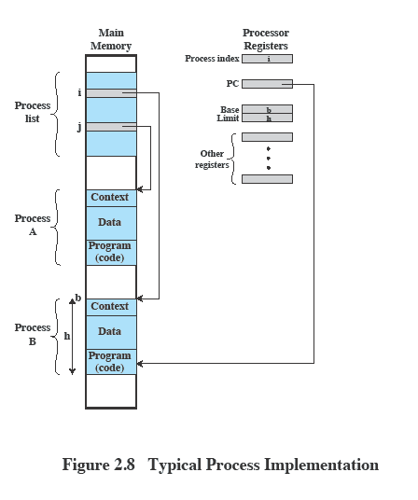
Process

Slide 34
Memory Management
Process isolation
Automatic allocation and management
Support of modular programming
Protection and access control
Long-term storage

Slide 35
Virtual Memory
Implements long-term store
Information stored in named objects called files
Allows programmers to address memory from a logical point of view

Slide 36
Paging
Allows process to be comprised of a number of fixed-size blocks, called pages
Virtual address is a page number and an offset within the page
Each page may be located anywhere in main memory
Real address or physical address is the main memory address

Slide 37
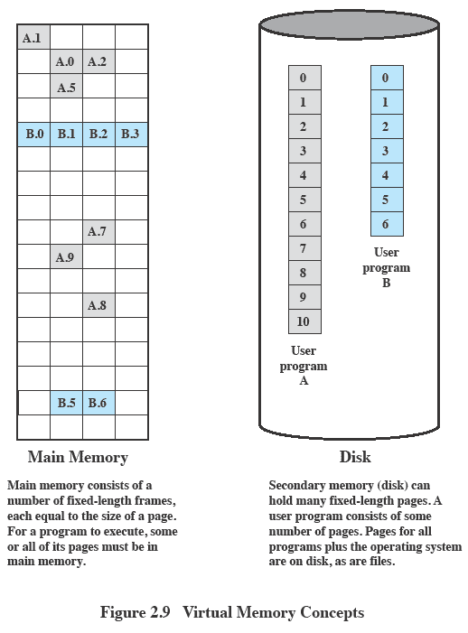
Virtual Memory

Slide 38
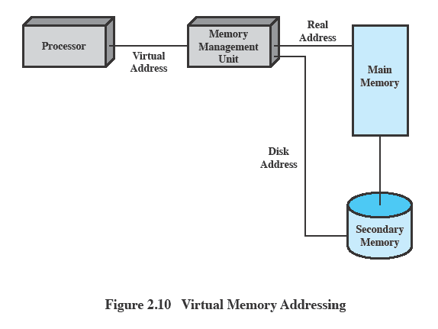
Virtual Memory Addressing

Slide 39
Information Protection and Security
Availability
Concerned with protecting the system against interruption
Confidentiality
Assuring that users cannot read data for which access is unauthorized

Slide 40
Information Protection and Security
Data integrity
Protection of data from unauthorized modification
Authenticity
Concerned with the proper verification of the identity of users and the validity of messages or data

Slide 41
Scheduling and Resource Management
Fairness
Give equal and fair access to resources
Differential responsiveness
Discriminate among different classes of jobs

Slide 42
Scheduling and Resource Management
Efficiency
Maximize throughput, minimize response time, and accommodate as many uses as possible

Slide 43
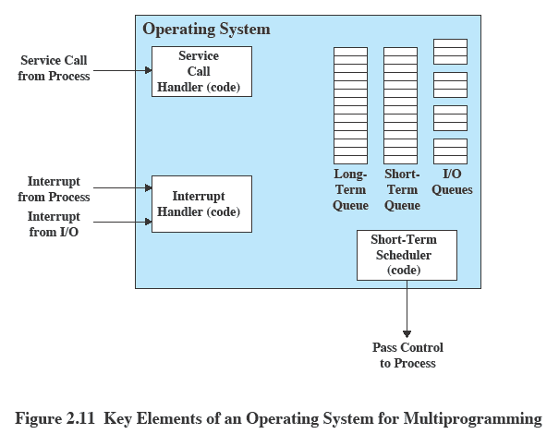
Key Elements of an Operating System

Slide 44
System Structure
View the system as a series of levels
Each level performs a related subset of functions
Each level relies on the next lower level to perform more primitive functions
This decomposes a problem into a number of more manageable subproblems

Slide 45
Levels
Level 1
Electronic circuits
Objects are registers, memory cells, and logic gates
Operations are clearing a register or reading a memory location
Level 2
Processor’s instruction set
Operations such as add, subtract, load, and store

Slide 46
Levels
Level 3
Adds the concept of a procedure or subroutine, plus call/return operations
Level 4
Interrupts

Slide 47
Concepts Related to Multiprogramming
Level 5
Process as a program in execution
Suspend and resume processes
Level 6
Secondary storage devices
Transfer of blocks of data

Slide 48
Concepts Related to Multiprogramming
Level 7
Creates logical address space for processes
Organizes virtual address space into blocks

Slide 49
Deal with External Objects
Level 8
Communication of information and messages between processes
Level 9
Supports long-term storage of named files
Level 10
Provides access to external devices using standardized interfaces

Slide 50
Deal with External Objects
Level 11
Responsible for maintaining the association between the external and internal identifiers
Level 12
Provides full-featured facility for the support of processes
Level 13
Provides an interface to the OS for the user

Slide 51
Modern Operating Systems
Microkernel architecture
Assigns only a few essential functions to the kernel
Address spaces
Interprocess communication (IPC)
Basic scheduling

Slide 52
Modern Operating Systems
Multithreading
Process is divided into threads that can run concurrently
Thread
Dispatchable unit of work
executes sequentially and is interruptable
Process is a collection of one or more threads

Slide 53
Modern Operating Systems
Symmetric multiprocessing (SMP)
There are multiple processors
These processors share same main memory and I/O facilities
All processors can perform the same functions

Slide 54
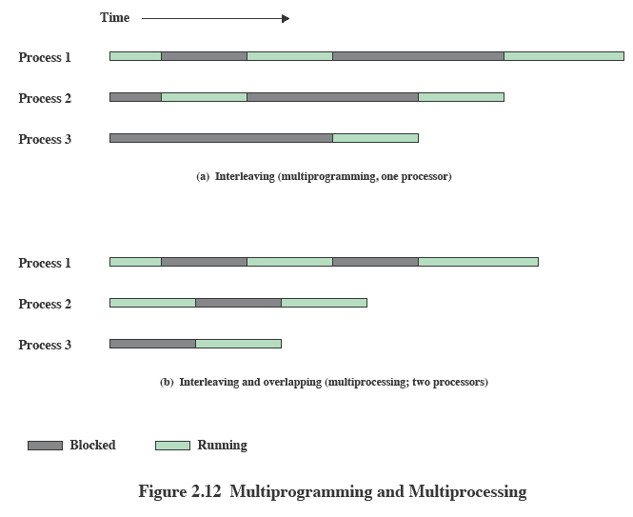
Multiprogramming and Multiprocessing

Slide 55
Modern Operating Systems
Distributed operating systems
Provides the illusion of a single main memory space and single secondary memory space

Slide 56
Modern Operating Systems
Object-oriented design
Used for adding modular extensions to a small kernel
Enables programmers to customize an operating system without disrupting system integrity

